Slide 1
Mental Health
Substance abuse- Alcoholism within New Zealand

Slide 2
Target group-
The target group I will be focusing on are people who suffer from alcoholism within New Zealand. One in five NZ adults suffer from alcoholism.
People of a somewhat older generation, maybe from 20/30- onwards. I have decided to use this demographic as they are less targeted on social media as not everyone of this generation has online profiles such as Facebook etc.
This would mean my health promotion initiative would need to be accessible by this generation.
Top idea so far is to have a little poster/ad/banner on the side of the NZ herald website which people click on, and are sent to the homepage of a new initiative/help line specifically directed at people suffering from alcoholism and mental illness, whether one has caused the other, vice versa.

Slide 3
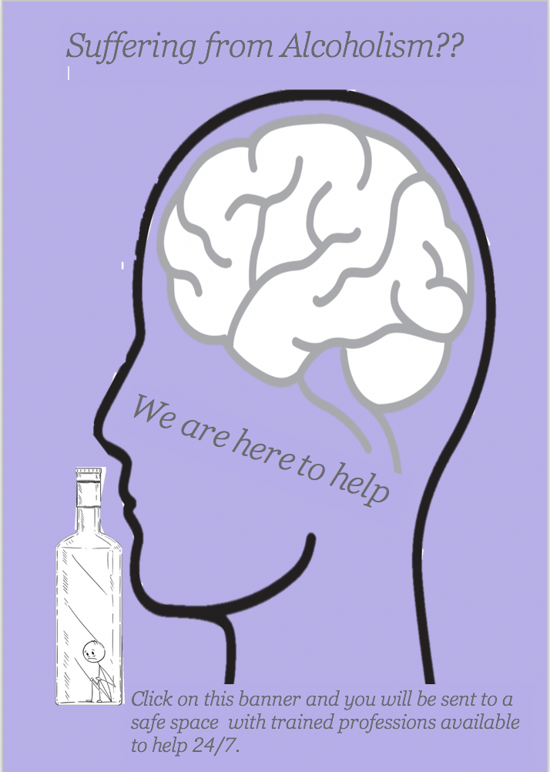
Idea-
To the side is an image of I am somewhat hoping to have my poster look like. (Rough idea)
The use of color has already been explained.
The images, of the brain and person are a symbol of mental illness. The image of the bottle represents alcoholism.
So far, I have not fully decided on what I want to write on the banner, I want it to be pretty self-explanatory with little wording but I’m not sure how to get that across yet.

